Slide 1
Numerically Solving the Allen-Cahn Equation
Josh Arrington
APC 523
May 07, 2024

Slide 2
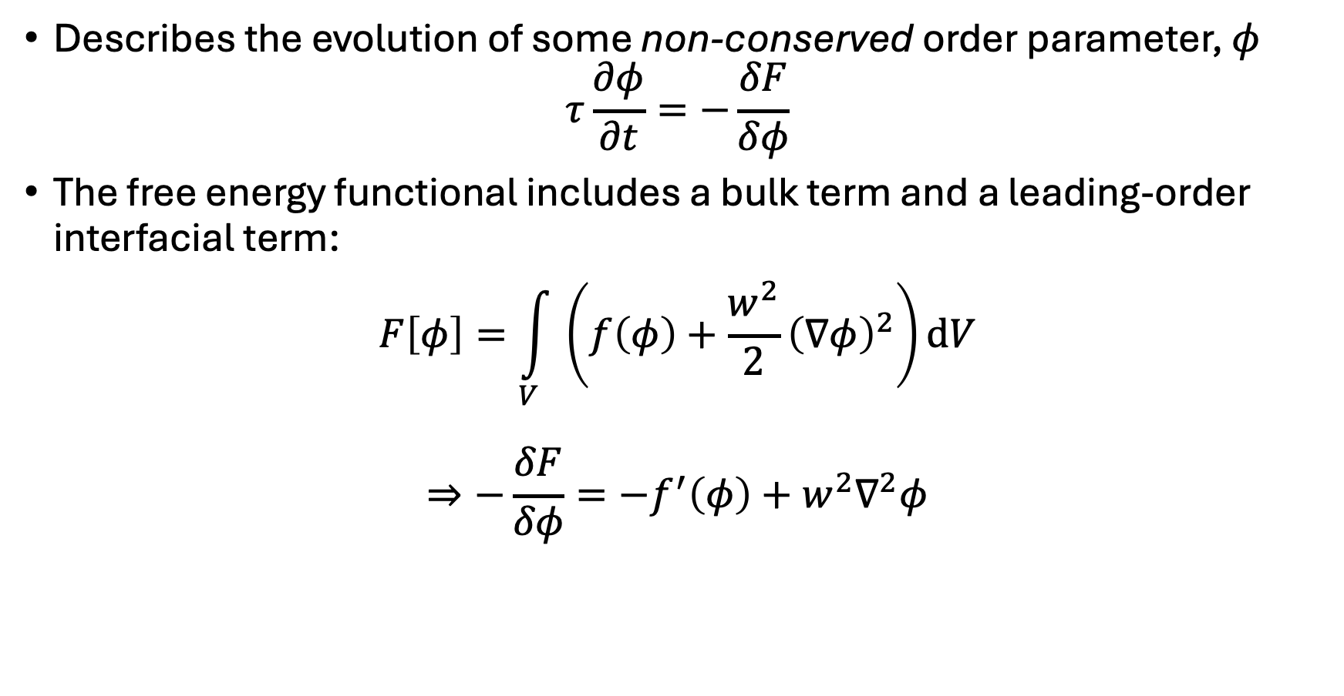
Allen-Cahn Equation
Describes the evolution of some non-conserved order parameter, $φ$
$$τ\frac{∂φ}{∂t}=−\frac{δF}{δφ}$$
The free energy functional includes a bulk term and a leading-order interfacial term:
$$F\left[φ\right]=\int_{V}{\left(f\left(φ\right)+\frac{w^{2}}{2}{\left(∇φ\right)}^{2}\right)dV}$$
$$⇒−\frac{δF}{δφ}=−f^{′}\left(φ\right)+w^{2}∇^{2}φ$$

Slide 3
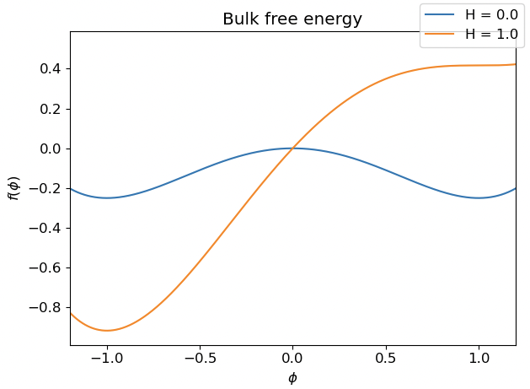
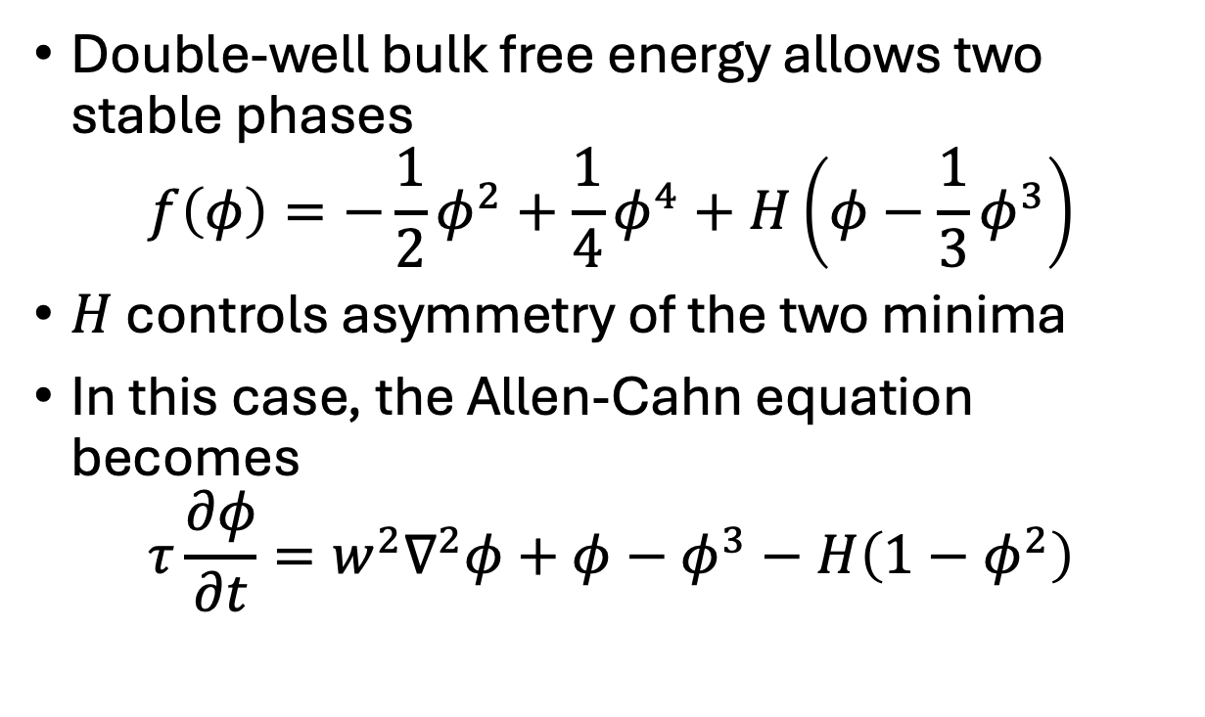
Double-well bulk free energy
Double-well bulk free energy allows two stable phases
$$f\left(φ\right)=−\frac{1}{2}φ^{2}+\frac{1}{4}φ^{4}+H\left(φ−\frac{1}{3}φ^{3}\right)$$
$H$ controls asymmetry of the two minima
In this case, the Allen-Cahn equation becomes
$$τ\frac{∂φ}{∂t}=w^{2}∇^{2}φ+φ−φ^{3}−H\left(1−φ^{2}\right)$$

Slide 4
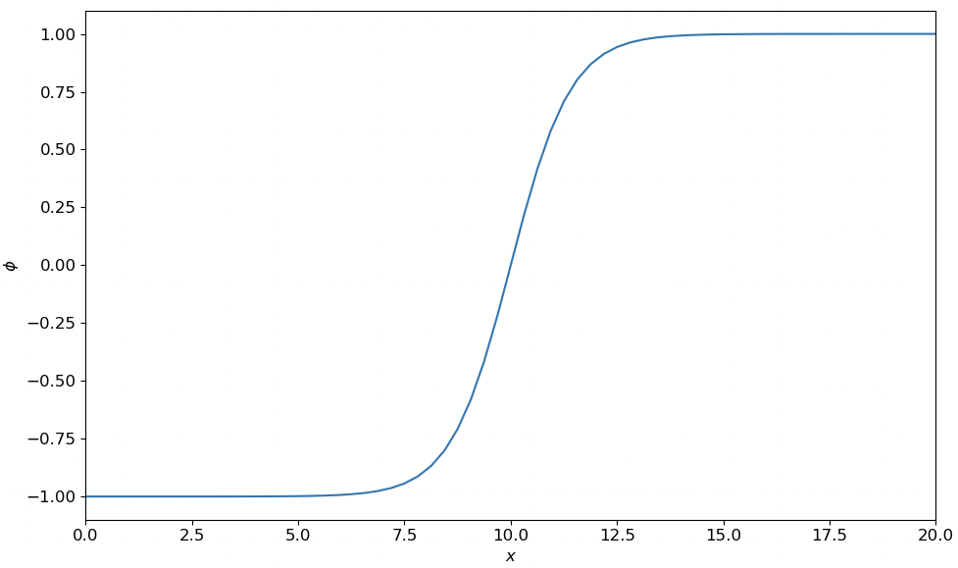
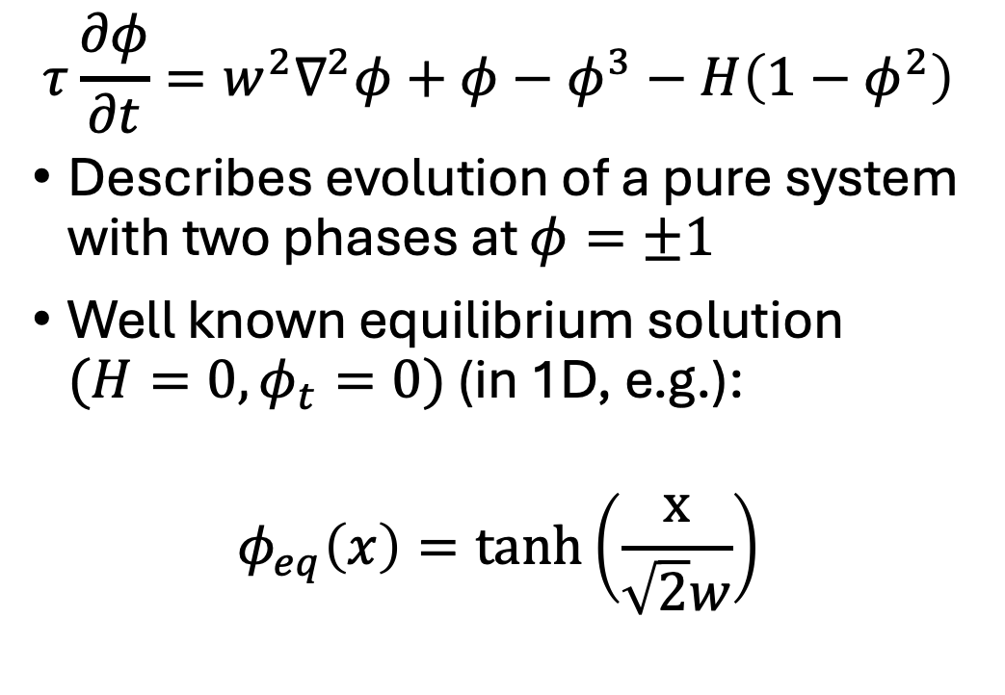
Analytically solving Allen-Cahn equation
$$τ\frac{∂φ}{∂t}=w^{2}∇^{2}φ+φ−φ^{3}−H\left(1−φ^{2}\right)$$
Describes evolution of a pure system with two phases at $φ=±1$
Well known equilibrium solution $(H=0, φ_{t}=0)$ (in 1D, e.g.):
$$φ_{eq}\left(x\right)=tanh\left(\frac{x}{\sqrt{2}w}\right)$$

Slide 5
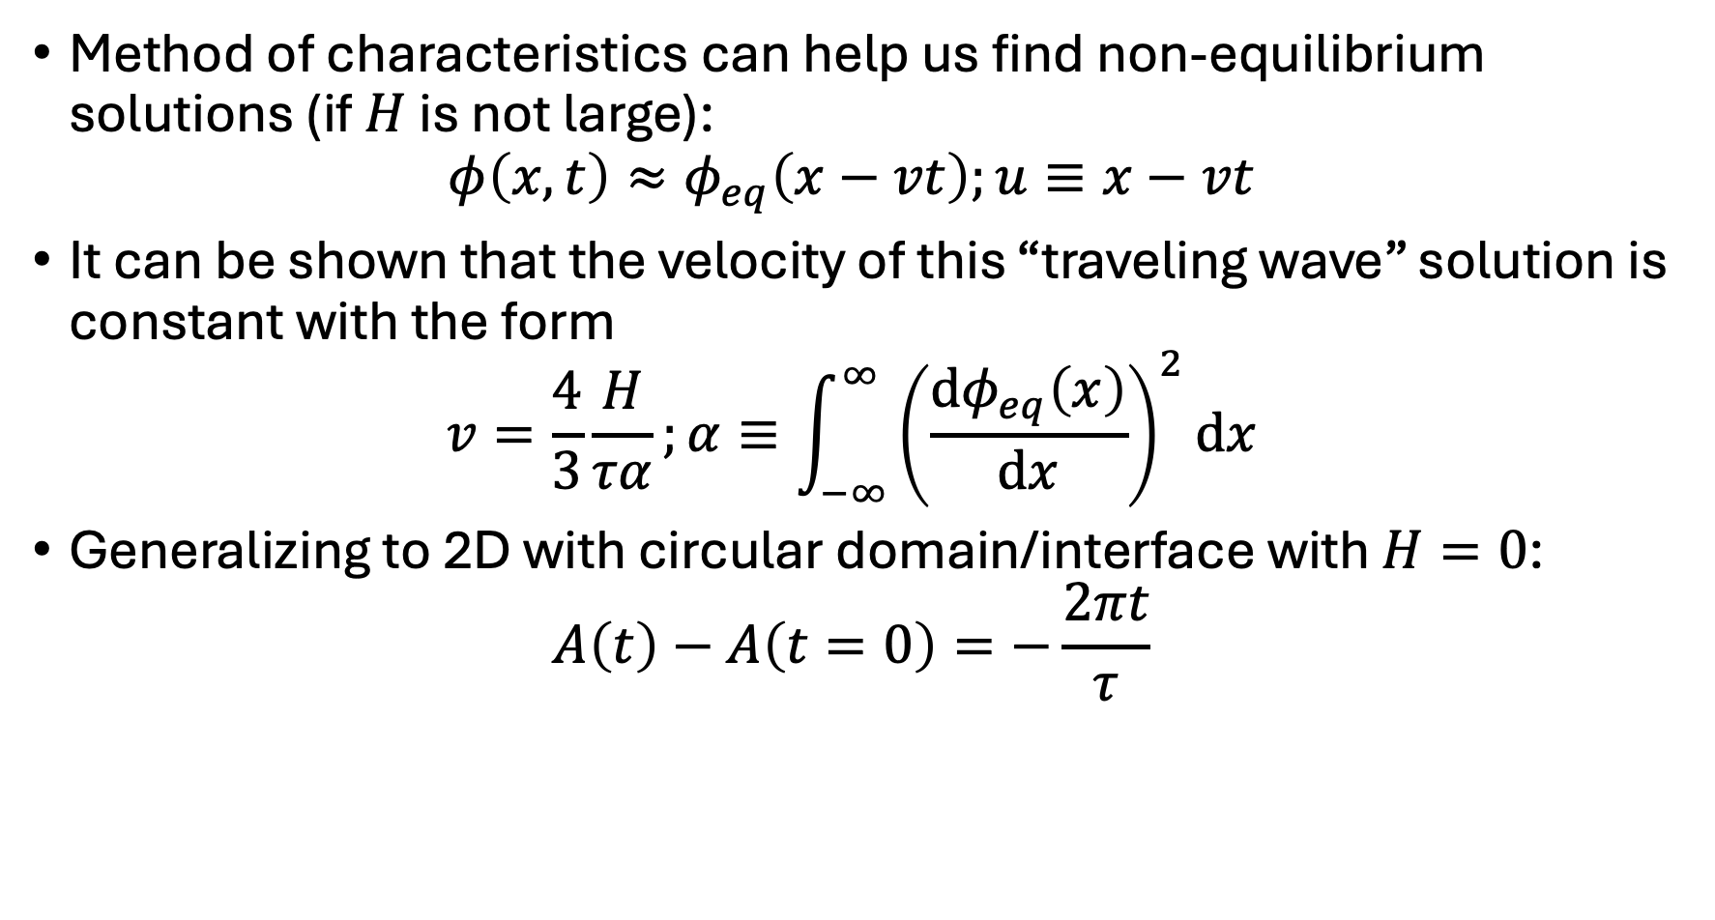
Analytically solving Allen-Cahn equation
Method of characteristics can help us find non-equilibrium solutions (if $H$ is not large):
$$φ\left(x,t\right)≈φ_{eq}\left(x−vt\right);u≡x−vt$$
It can be shown that the velocity of this “traveling wave” solution is constant with the form
$$v=\frac{4}{3}\frac{H}{τα};α≡\int_{−∞}^{∞}{{\left(\frac{dφ_{eq}\left(x\right)}{dx}\right)}^{2}dx}$$
Generalizing to 2D with circular domain/interface with $H=0$:
$$A\left(t\right)−A\left(t=0\right)=−\frac{2πt}{τ}$$

Slide 6
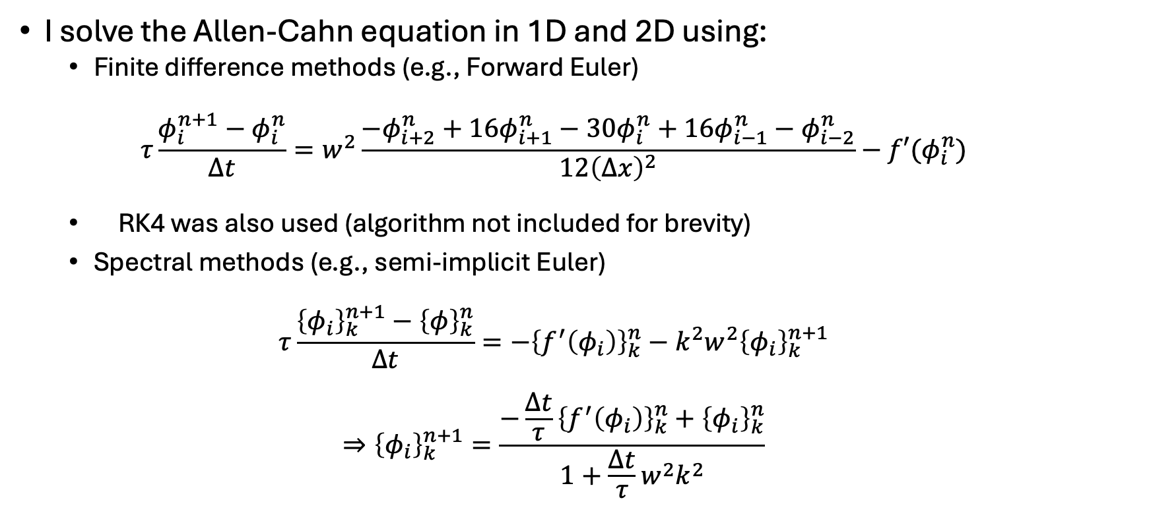
Numerical Methods
I solve the Allen-Cahn equation in 1D and 2D using:
Finite difference methods (e.g., Forward Euler)
$$τ\frac{φ_{i}^{n+1}−φ_{i}^{n}}{Δt}=w^{2}\frac{−φ_{i+2}^{n}+16φ_{i+1}^{n}−30φ_{i}^{n}+16φ_{i−1}^{n}−φ_{i−2}^{n}}{12{\left(∆x\right)}^{2}}−f′(φ_{i}^{n})$$
RK4 was also used (algorithm not included for brevity)
Spectral methods (e.g., semi-implicit Euler)
$$τ\frac{{\left\{φ_{i}\right\}}_{k}^{n+1}−{\left\{φ\right\}}_{k}^{n}}{∆t}=−{\left\{f^{′}\left(φ_{i}\right)\right\}}_{k}^{n}−k^{2}w^{2}{\left\{φ_{i}\right\}}_{k}^{n+1}$$
$$⇒{\left\{φ_{i}\right\}}_{k}^{n+1}=\frac{−\frac{∆t}{τ}{\left\{f^{′}\left(φ_{i}\right)\right\}}_{k}^{n}+{\left\{φ_{i}\right\}}_{k}^{n}}{1+\frac{∆t}{τ}w^{2}k^{2}}$$

Slide 7
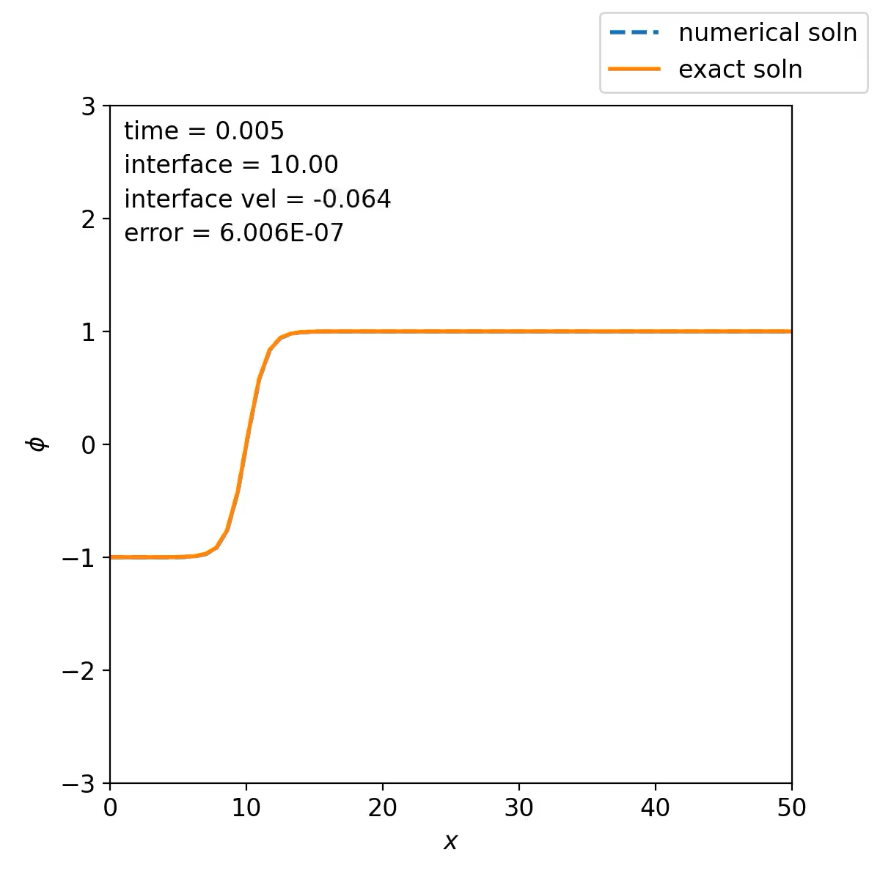


1D solution: profile evolution
FD
RK4
FFT

Slide 8
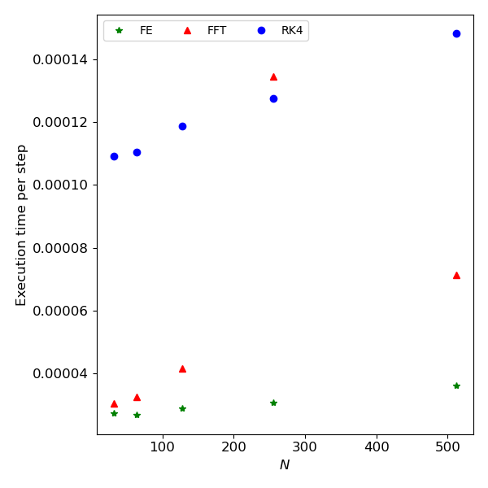
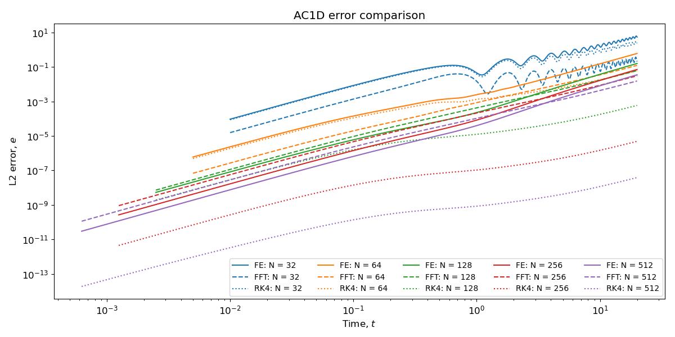
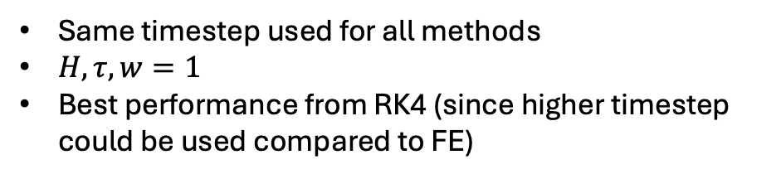
1D solution: error and execution time
Same timestep used for all methods
$H,τ,w=1$
Best performance from RK4 (since higher timestep could be used compared to FE)

Slide 9
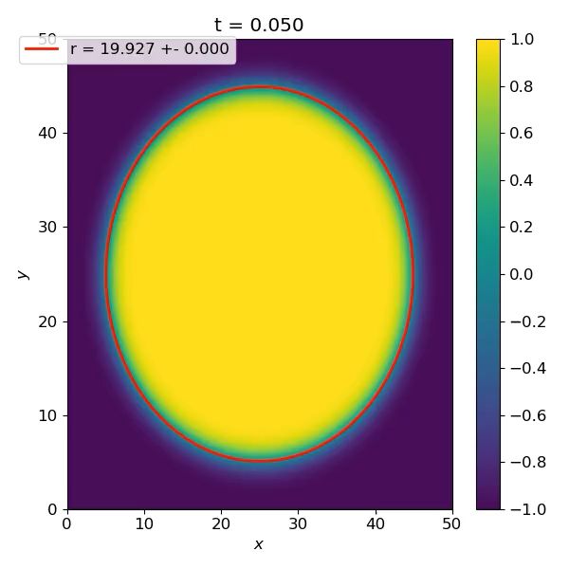
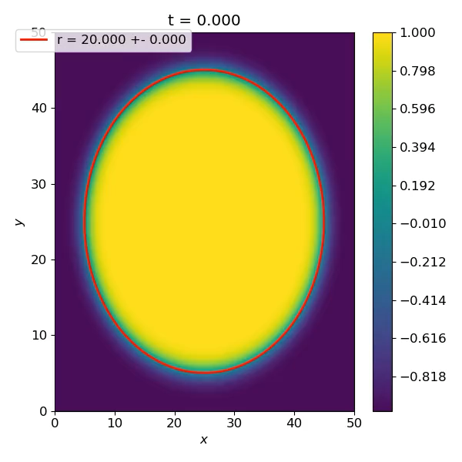
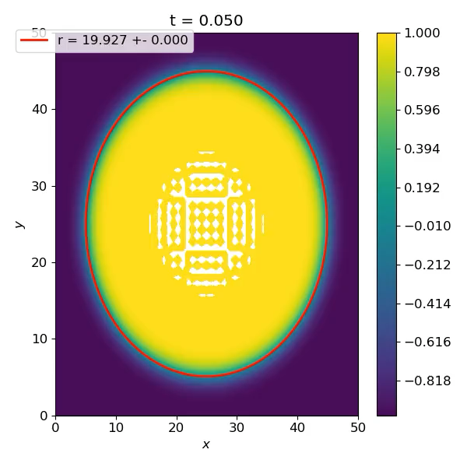
2D solution: evolution of interface
$H≠0$ for illustrative purposes; error compared to analytical evaluated for $H=0$
FE
RK4
FFT

Slide 10
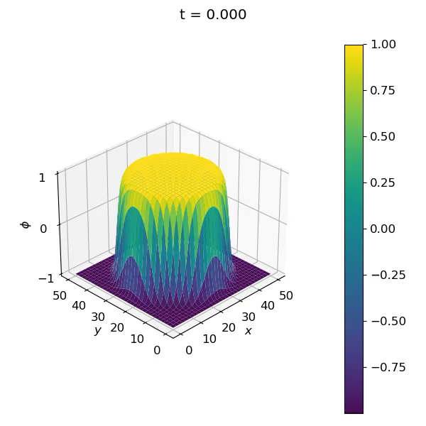
2D FFT solution: oscillations miniscule in magnitude

Slide 11
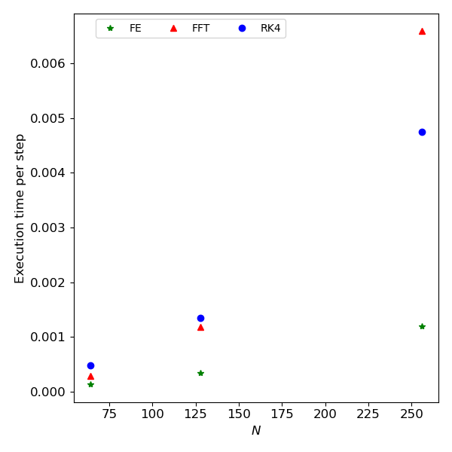
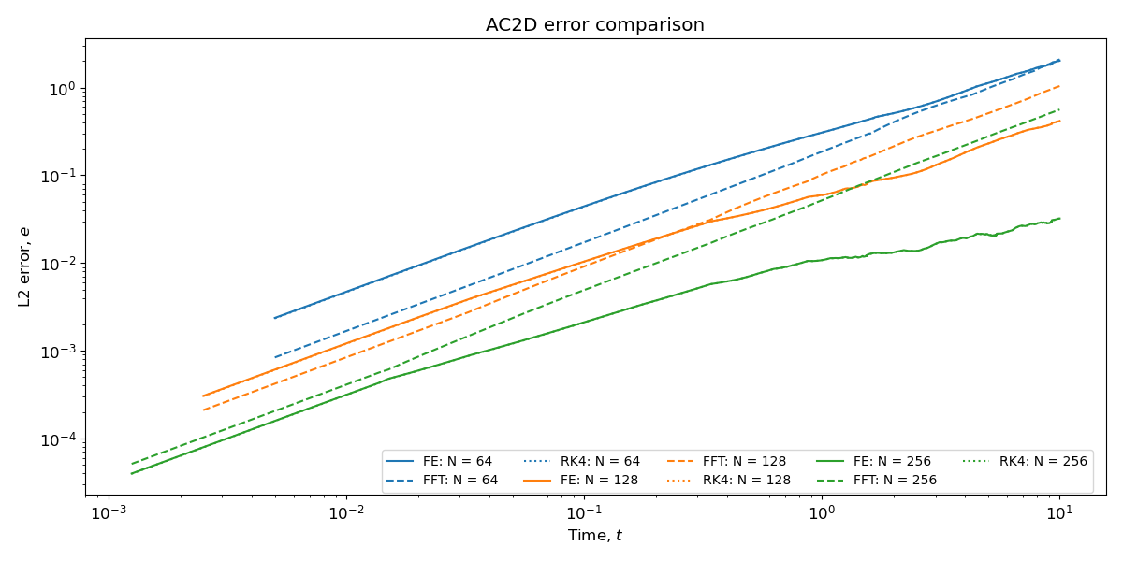
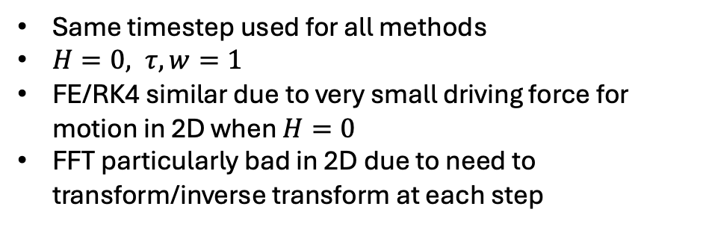
2D solution: error and execution time
Same timestep used for all methods
$H=0, τ,w=1$
FE/RK4 similar due to very small driving force for motion in 2D when $H=0$
FFT particularly bad in 2D due to need to transform/inverse transform at each step

Slide 12
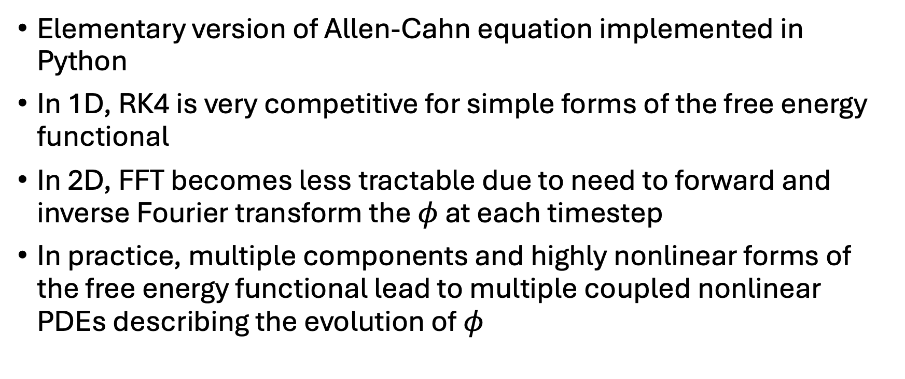
Conclusions
Elementary version of Allen-Cahn equation implemented in Python
In 1D, RK4 is very competitive for simple forms of the free energy functional
In 2D, FFT becomes less tractable due to need to forward and inverse Fourier transform the $φ$ at each timestep
In practice, multiple components and highly nonlinear forms of the free energy functional lead to multiple coupled nonlinear PDEs describing the evolution of $φ$

